Slide 1
Regression Group Project
Group 3
02 June 2025
Dembe Tsiwana
Khuthadzo Tshikovhele
Aston Greeves

Slide 2
Overview
The following presentation demonstrates models that were built using the CO2 Emissions data where we will be predicting emissions per area using the data provided.
Table of Content
Summary of Data Handling, Analysis, and Visualization
Data Processing
Exploratory Data Analysis
Model Testing results
Conclusion

Slide 3
Summary of Data Handling, Analysis, and Visualization
Powerful Toolkit of Packages that we used:
Scikit-learn: Essential for machine learning tasks, including preprocessing, modeling, and evaluation.
SciPy: Provides additional functionality for scientific computing.
Matplotlib/Seaborn: Crucial for creating various types of visualizations.
NumPy: Fundamental for numerical operations, supporting arrays and matrices.
Pandas: Essential for data manipulation, including reading, cleaning, and analysing data
Jupyter Notebook: Facilitates an interactive environment for coding and data exploration.
These packages collectively provide a comprehensive toolkit for efficient data handling, analysis, and visualization, enhancing our ability to derive meaningful insights from data.

Slide 4
Data Preprocessing
We conducted several data preprocessing tasks to ensure our dataset was well-prepared for analysis and visualization:
Removing Duplicates: Eliminated redundant rows
Filtering Data: Selected specific data based on conditions..
Column Names: Checked and displayed column names.
Initial Data Display: Showed the first few rows for a quick overview.
Loading the Dataset: Imported the data into a dataframe
Converting Data Types: Ensured columns had appropriate data types.
Renaming Columns: Standardized column names to lowercase.
Removing Outliers: Used the IQR method to filter out extreme values.
Filling Missing Values: Replaced NaNs with column means.
Normalizing Data: Scaled numeric columns and combined them with non-numeric columns.
This comprehensive approach resulted in a complete, cleaned, and processed dataframe, ready for further analysis and visualization.

Slide 5
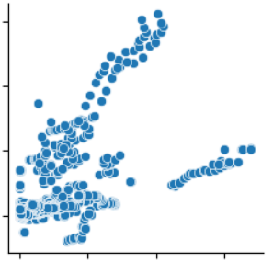
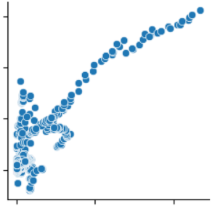
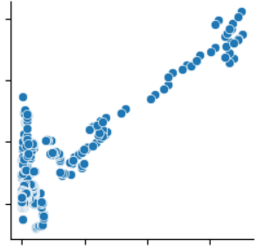
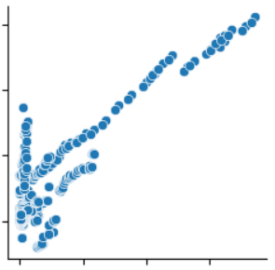
Exploratory Data Analysis
Correlations between variables
The above visual shows the correlations between total_emission and:
Food_transport
Food_household_consumption
Food_packaging
IPPU
These correlations indicate that in areas where it is more industrialized total_emission is higher, e.g. when food processing increases then so does emission showing a positive correlation.

Slide 6
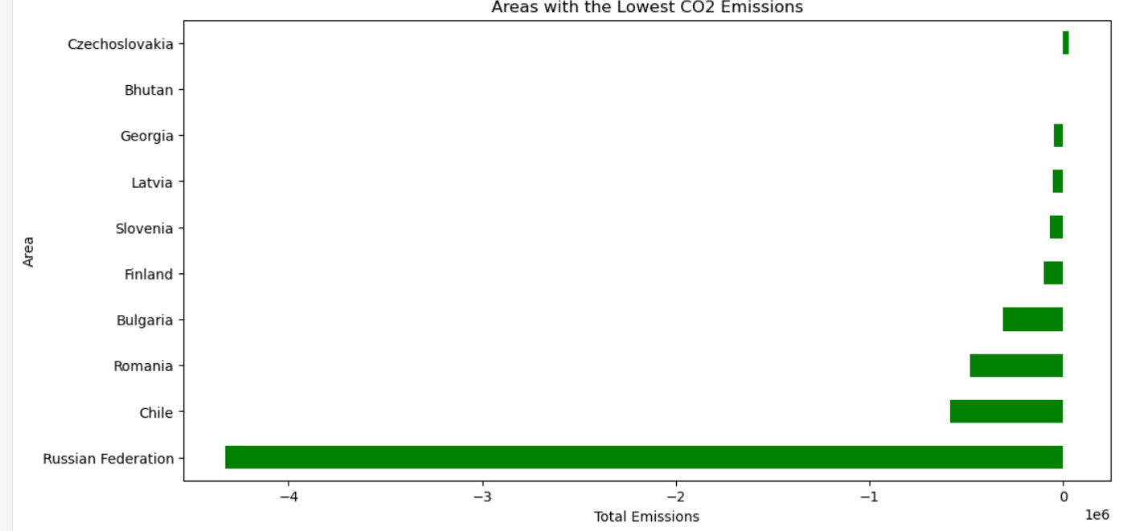
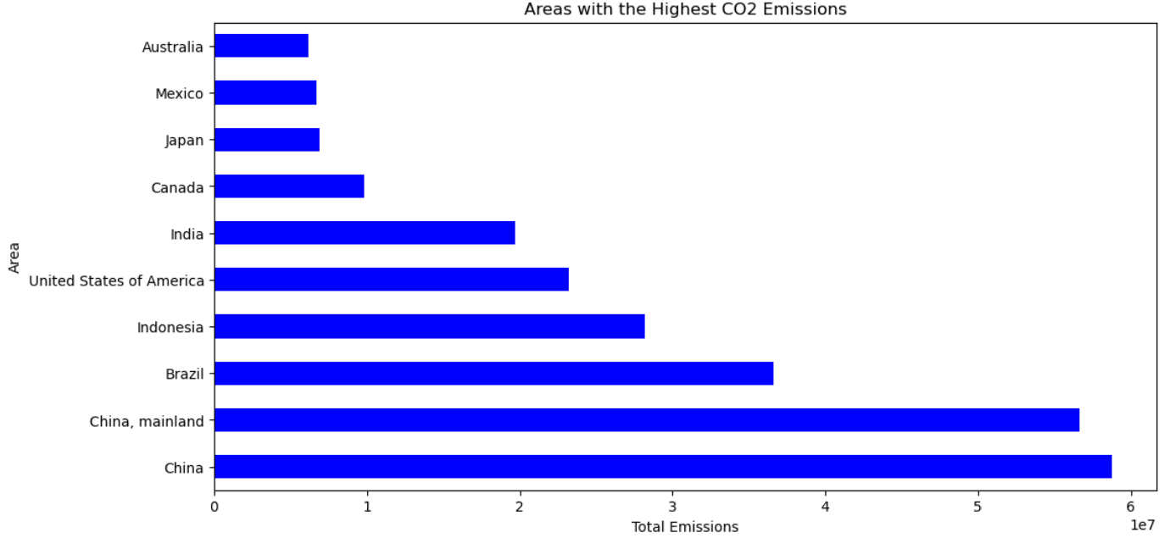
Areas with the highest/lowest CO2 Emissions
Areas with higher urban population numbers generally have higher CO2 emissions this can be attributed to the increase in the need for food production.

Slide 7
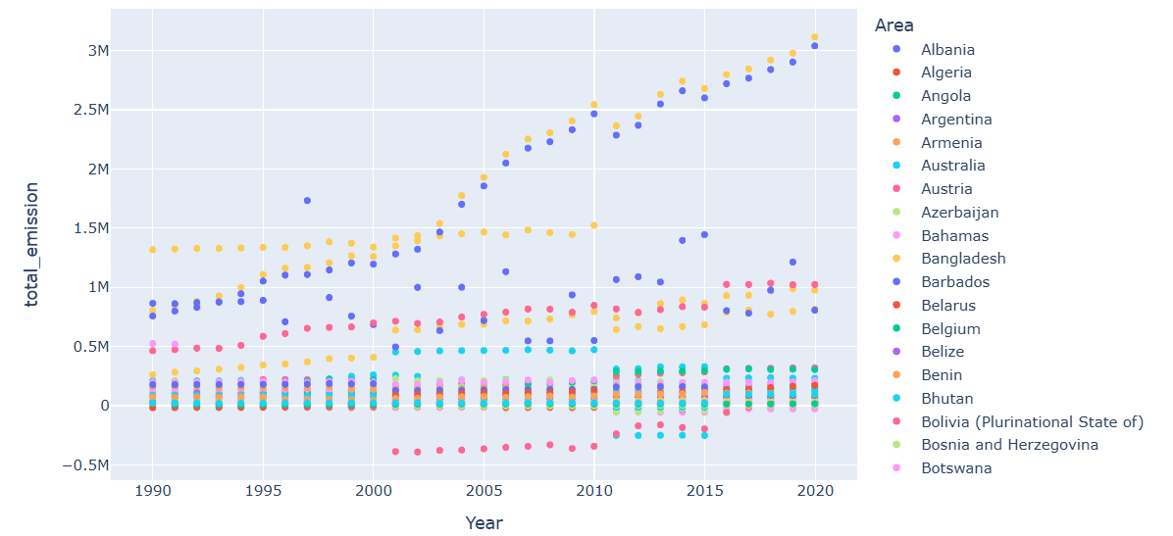
Relationship between Emissions and Year
The scatter plot shows the relationship between total_emission and year where as the years progress the total emission increases in areas where the total_population is higher. This could be indicative of developments within the areas where production is increasing.

Slide 8
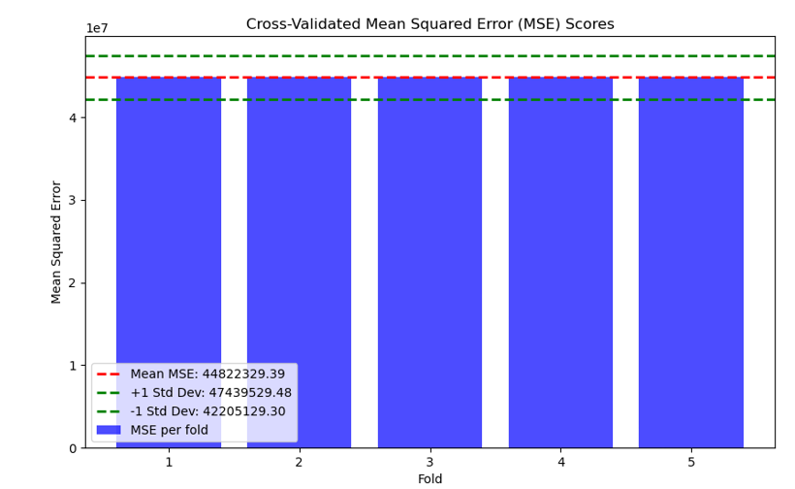
Model Testing
Cross validation Regression Testing
Each blue bar represents the MSE from one fold in the 5-fold cross-validation.
The red dashed line shows the mean MSE across all folds: 44,822,329.39.
The green dashed lines represent ±1 standard deviation from the mean:
Upper bound: 47,439,529.48
Lower bound: 42,205,129.30.
The consistency of the bars (all being equal in this case) suggests that the model performs very similarly across all folds
This indicates stable model performance, with low variability in prediction error across different data splits.

Slide 9
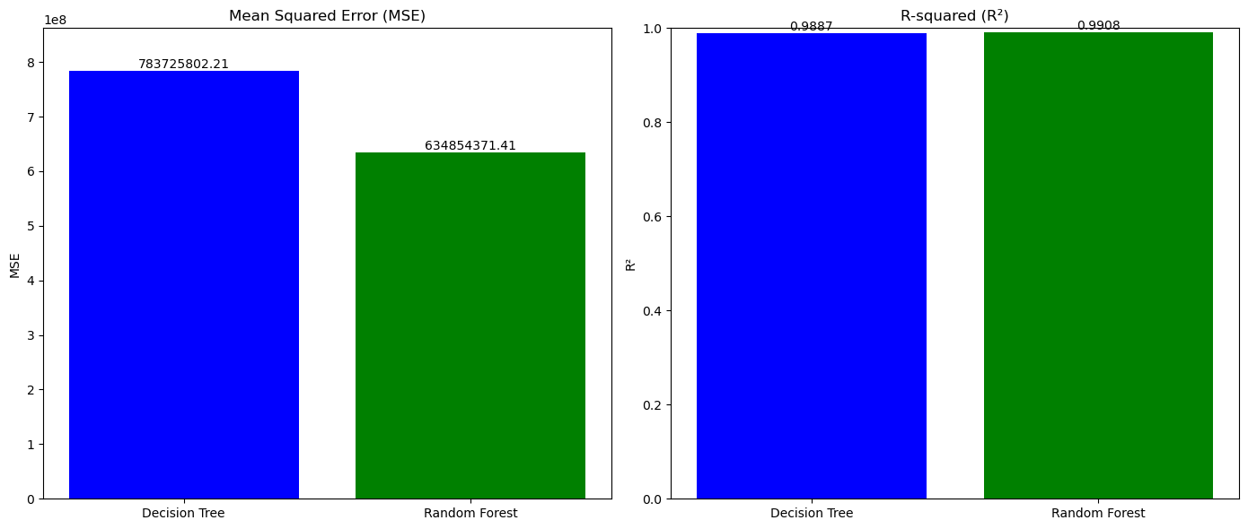
Model Testing
Decision Tree and Random Forest Regression Testing
Left Chart (MSE):
Random Forest has a lower Mean Squared Error, indicating better prediction accuracy.
Right Chart (R²):
Both models have high R² values, but Random Forest performs slightly better, explaining more variance in the target variable.
This confirms that Random Forest is more accurate and robust than a single Decision Tree.

Slide 10

Conclusion
Summary of Findings and Model Evaluation
Variable Relationships:
Strong correlations were identified between CO₂ emissions and variables such as:
Urban population
Food household consumption
IPPU (Industrial Processes and Product Use)
Food packaging
Higher urban populations tend to drive up food demand, which in turn increases CO₂ emissions.
Model Performance:
Linear Regression:
R²: 0.999998 – explains nearly all variance.
MSE: High – indicates some prediction error.
K-Fold validation revealed a much higher MSE, suggesting possible overfitting.
Decision Tree:
MSE: ~783 million
R²: 0.9887
Random Forest:
MSE: ~634 million
R²: 0.9908
Best overall performance due to higher accuracy and better generalization.
✅ Conclusion: Random Forest is the most reliable model for predicting CO₂ emissions, offering a strong balance between precision and robustness.

